Slide 1
GEO Grid Workshop
October 17, 2011
Sapporo Convention Center

Slide 2
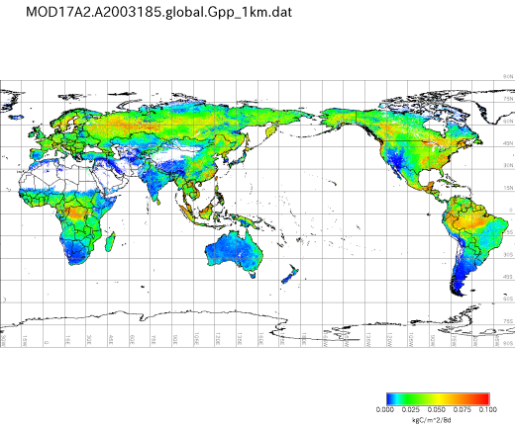
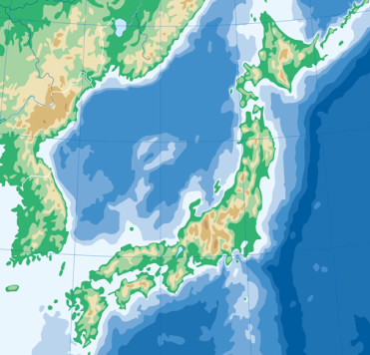
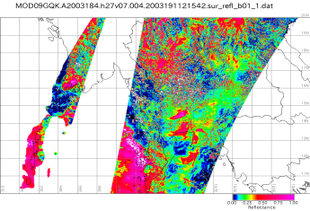
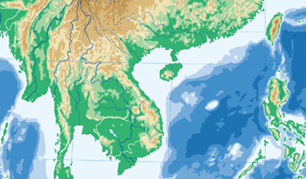
アプリケーションによるGEO Gridの評価
Asia GEO Grid Initiative
PI: Yoshio Tanaka (AIST)
Calibration of satellite
Data using in-situ data
Global CO₂ Map
１．Catalogue Search
２．Obtain data
３．Process data
４．visualize
Objective: To deploy Asia GEO Grid Infrastructure in Asia to share Earth observation data and computing resources for Earth sciences.
Thailand
Taiwan
Japan
Japan
Flux Data
Satellite Data
Thailand
AsiaFlux Network

Slide 3
Organization
Promotion Committee
(External members)
AsiaFlux Network
AIST, Japan
NIES, Japan
Project management
Development and management of Asia GEO Grid Infrastructure
Development of model cases at Flux observation sites.
PRAGMA/CREON Joint WS (2011)
OGC TC Meeting （2012)
Development of model cases at Flux observation sites.
Leading collaborations with AsiaFlux Network.
ＰＲＡＧＭＡ
OGC
OGF
NSTDA/NECTEC, Thailand
VAST, Vietnam
NARL/NCHC, Taiwan
Promotion of collaboration with ThaiFlux
Development of “Information Grid” and “Environment Informatorium”.
Evaluation of Asia GEO Grid Infrastructure.
Development of GEO Grid Infrastructure in Vietnam
Understanding Physics, Mathematics used in weather research and forecasting model.
Evaluation of Asia GEO Grid Infrastructure.
Development of near-real-time pipeline for processing satellite images to support in-situ image data to disaster prevention center.
Support TaiwanFlux to provide Flux data by GEO Grid middleware.

Slide 4
Agenda (beforenoon)
Morning, Oct. 17 (Mon) |  | Session 1: Opening
 | 10:00-10:15 | Welcome and Opening Remarks | Yoshio Tanaka (AIST)
 | 10:15-11:00 | Invited Talk: Integrative use of AsiaFlux Network Observations for Continental-scale Estimates of Carbon Budget | Nobuko Saigusa (NIES)
 |  | Session 2: Updates from member institutions (1)
 | 11:00-11:30 | Introduction of Asia GEO Grid Initiative | Yoshio Tanaka (AIST, Japan)
 | 11:30-12:00 | Calibration and validation for space-based optical sensors | Hirokazu Yamamoto (AIST, Japan)
 | 12:00-13:30 | Lunch Break

Slide 5
Agenda (afternoon)
Afternoon, Oct. 17 (Mon) |  | Session 3: Updates from member institutions (2)
 | 13:30-14:00 | Current Status of 3D GIS Taiwan Platform and Its Cloud Service | Whey-Fone Tsai (NCHC, Taiwan)
 | 14:00-14:30 | Development and Practices in Location-based Environmental Monitoring | Fang-Pang Lin (NCHC, Taiwan)
 | 14:30-15:00 | Environmental Informatorium : One-stop and multi-faceted observation data service | Apivadee Piyatumrong (NECTEC, Thailand)
 | 15:00-15:30 | Coffee Break
 |  | Session 4: Updates from member institutions (3)
 | 15:30-16:00 | VAST's GEO Grid IT Infrastructure Research and Solution Proposal | Tuyet Dao Van (VAST, Vietnam)
 | 16:00-16:30 | SFI: Framework for Integration of Satellite Data and Field Sensor Data | Sarawaut Ninsawat (AIT, Thailand)
 | 16:30-17:00 | Closing

Slide 6
Introduction of Asia GEO Grid Initiative
Yoshio Tanaka
AIST, Japan

Slide 7

What is the GEO Grid ?
Name of the AIST’s project as well as concept.
The GEO (Global Earth Observation) Grid is aiming at providing an E-Science Infrastructure for worldwide Earth Sciences communities to accelerate GEO sciences based on the concept that relevant data and computation are virtually integrated with a certain access control and ease-of-use interface those are enabled by a set of Grid and Web service technologies.
AIST: OGF Gold sponsor (a founding member)
AIST: OGC Associate member (since 2007)
Satellite Data
Grid
Technologies
Geology
Map
Geo* Contents
Applications
GIS data
Resources
Environment
Field data
Disaster
mitigation

Slide 8
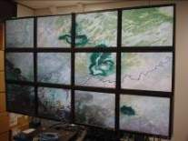
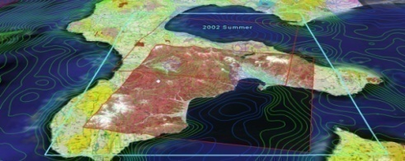
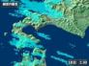
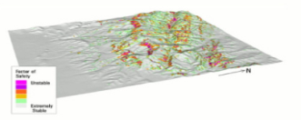
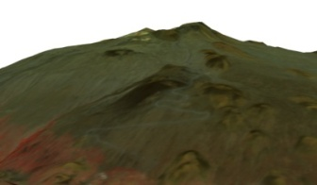
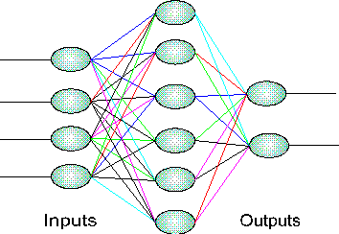
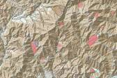

Example: Flood simulation
Visualize Hi-Resolution Hazard Map
GIS Data
Rain Sensors
GEO
MET
ASTER
Digital Elevation Map
Created by
ASTER Satellite Images
Neural-Map based Data Mining / Landslide Simulation on Large Cluster Computers

Slide 9
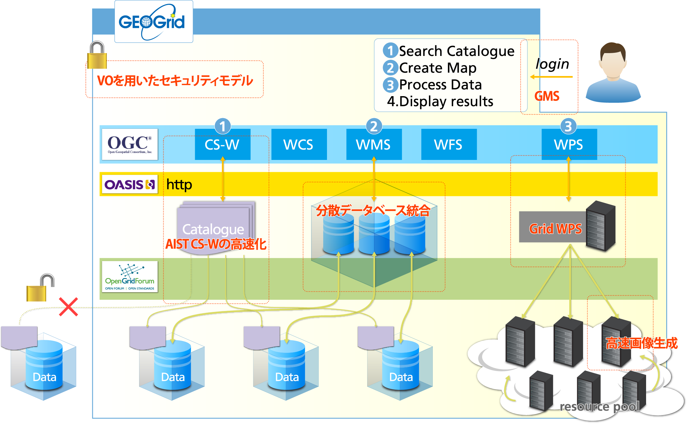
Why Grid?
security
Federation of distributed DBs
High performance CSW
HPC
By courtesy of S.Sekiguchi

Slide 10
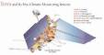


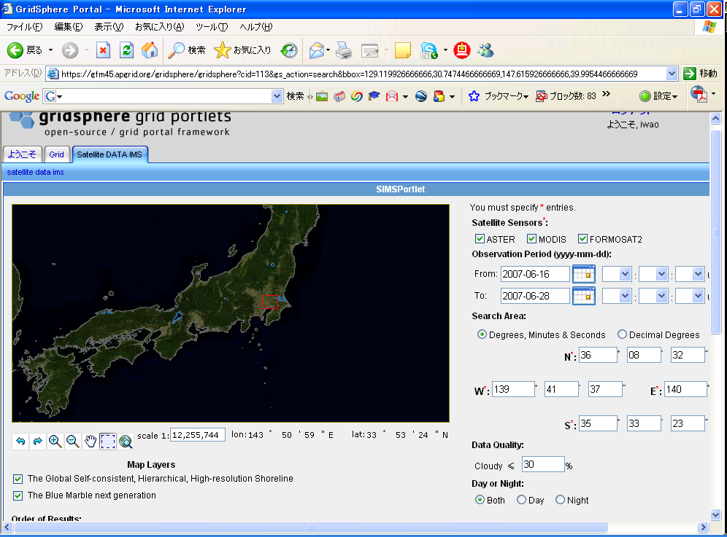
GEO Grid Services
Terra/ASTER
login
user
Account
DB
account (GAMA)
server
TDRS
credential
VO DB
VO (VOMS)
server
APAN/TransPAC
portal server
GET
query
exec
GSI +
VOMS
ERSDIS/NASA
GSI + VOMS
GSI + VOMS
CSW
OGSA
DAI
WFS
WCS
WMS
GRAM
GridFTP
８４０ＴＢ
GIS
server
map
server
catalogue/
metadata
server
gateway
server
GEO Grid Cluster
L0
L0
L0
L0
L0
L0
L0
L0
Data
Maps
Meta data
Storage
L0
L0
L0
L0

Slide 11


Current Configuration of GEO Grid system in AIST
CS-W
WMS
WFS
WCS
WPS
SOS
csw.geogrid.org
ows.geogrid.org
wps.geogrid.org
52NorthSOS
1G
R
GDAL
GRASS GIS
Apache
Apache
Apache
Apache
rpy2
Mapserver
Mapserver
Mapserver
Mapserver
L0/L1
L0/L1
L0/L1
L0/L1
etc
etc
etc
etc
Node
Metadata
L3
L3
L3
L3
geotiff
geotiff
geotiff
geotiff
Sensor Node
(e.g. Live E!, JapanFlux)
basemap
basemap
basemap
basemap
QQ
QQ
QQ
QQ
ASTER Data Archive
AIST Green Cloud

Slide 12

Extension to outside of AIST is easy!
WPS
CSW
WMS
WFS
Storage
WCS
Other site
Other site
CS-W
WMS
WFS
WCS
WPS
SOS
csw.geogrid.org
ows.geogrid.org
wps.geogrid.org
52NorthSOS
1G
R
GDAL
GRASS GIS
Apache
Apache
Apache
Apache
rpy2
Mapserver
Mapserver
Mapserver
Mapserver
L0/L1
L0/L1
L0/L1
L0/L1
etc
etc
etc
etc
Node
Metadata
L3
L3
L3
L3
geotiff
geotiff
geotiff
geotiff
Sensor Node
(e.g. Live E!, JapanFlux)
basemap
basemap
basemap
basemap
QQ
QQ
QQ
QQ
ASTER Data Archive
AIST Green Cloud

Slide 13
GEO Grid Service Examples
Satellite data archive and processing
ASTER, PALSAR, MODIS, etc.
Satellite data application
Application of Satellite-Field data Integrator (SFI) for aerosol monitoring Description http://fon.geogrid.org/aerosol/
SDCP (Science Degree Confluence Project) –Community validation tool for global land-cover & digital elevation models http://eco.geogrid.org/sdcp/
Hazard information
QuiQuake (Quick Estimation System for Earthquake Maps Triggered by Observation Records) http://qq.ghz.geogrid.org/QuakeMap/index.en.html
Volcanic Gravity Flow Simulations on Volcanic Area http://volcano.geogrid.org/applications/EnergyCone/
Geoscience data
Geological maps, Active fault data, etc.

Slide 14
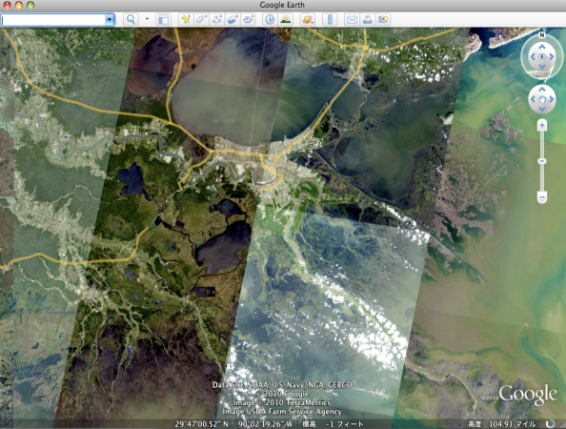
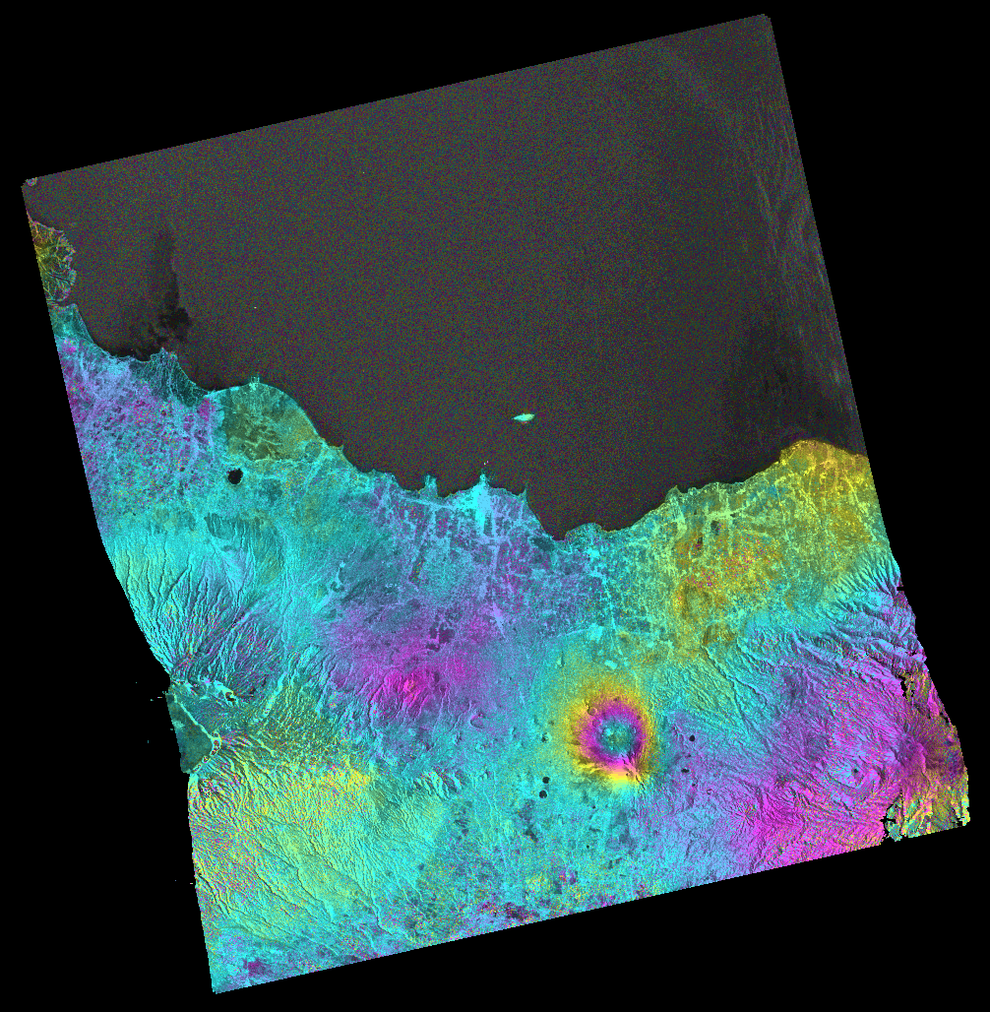
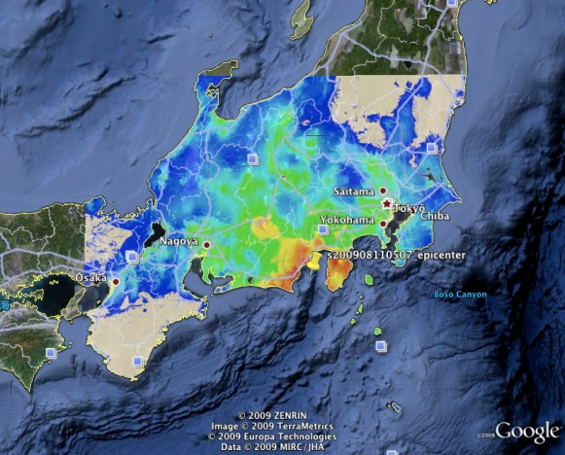
GEO Grid Applications (examples)
Satellite-Field Integrator
WMS Viewer on GEE
Monitoring of diastrophism
Quick Estimation System for Earthquake Map

Slide 15
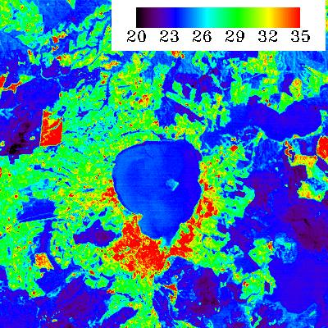
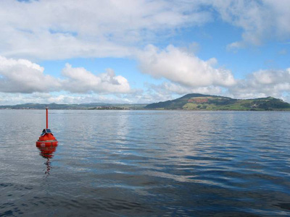
Synergy between Satellite imagery and in-situ data
ASTER temperature map
In-situ temperature measurements

Slide 16
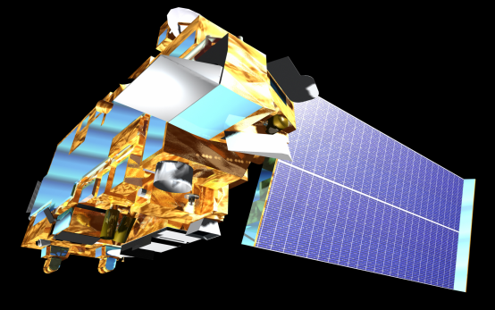
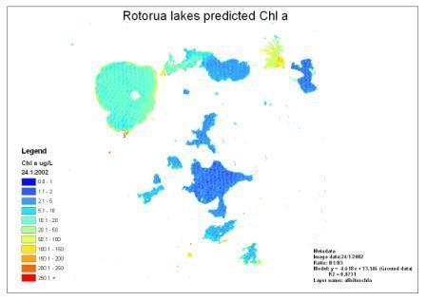

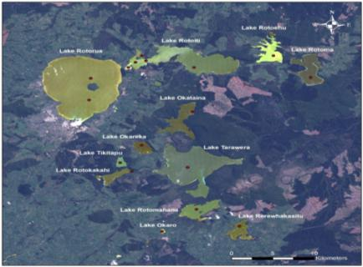
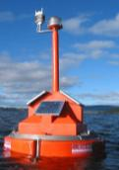
Synergy of satellite and field data
SOS=Sensor Net
WPS= Satellite data processing
Accurate water quality map production with GLEON

Slide 17
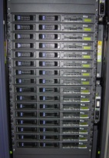
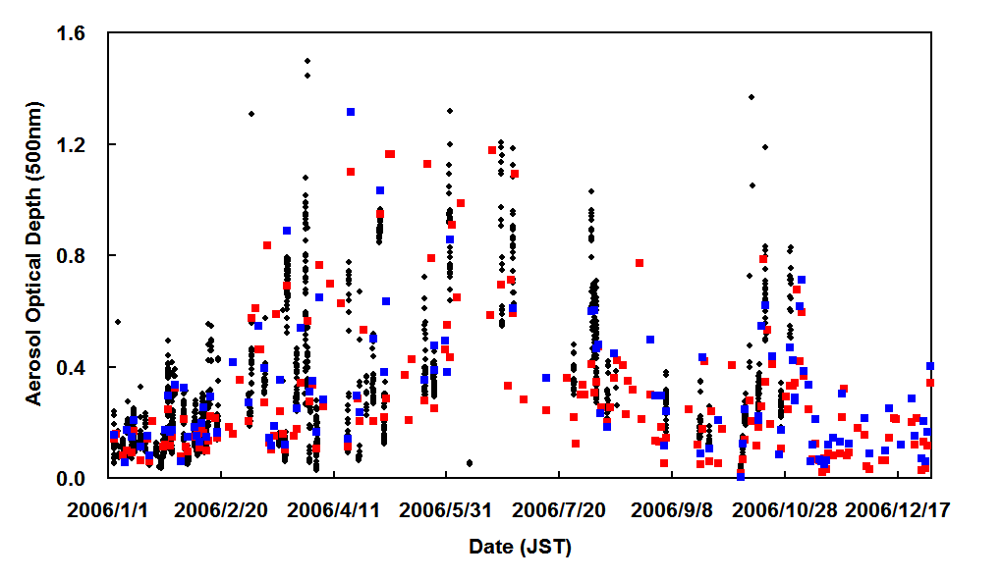
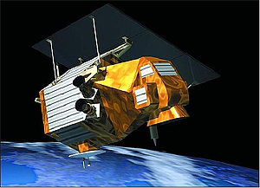

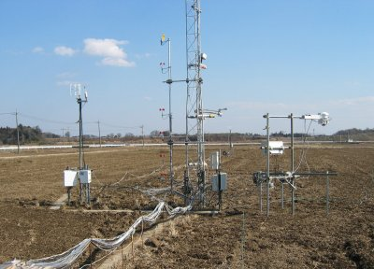
Calibration / validation of Satellite Data using Field Sensor Data
Calibration and Validation processing
AAA Service
Resource WG
Credential
Repository
1. login
Web Processing Service (WPS)
Access Control by GSI + VOMS
VOMS
2. VOMS proxy
VO Admin
5. Results
4. Inputs
VO member
DB
3. Search
Access Control by GSI + VOMS
Sensor Observation Service (SOS)
Web Coverage Service (WCS)
Formsat-2
ASTER / MODIS
GLEON
PEN / Live E!
Satellite Sensors
Field Sensors

Slide 18
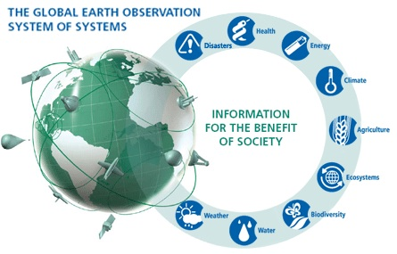
Background of the project
Understanding the Earth system is crucial to enhancing human health, safety and welfare, protecting the global environment, reducing disaster losses, etc.
GEOSS 10-Year Implementation Plan at Earth Observation Summit (2005).
The G8 leaders further agreed to accelerate efforts to strengthen observation, prediction and data sharing within GEOSS in their Declaration on Environment and Environment adopted in Toyako, Japan (2008).
Coping with environmental changes is a common and important issue in Asian countries.
Federation of distributed and heterogeneous Earth observation data is the key to implement the Global Earth Observation System of Systems.
© GEO

Slide 19

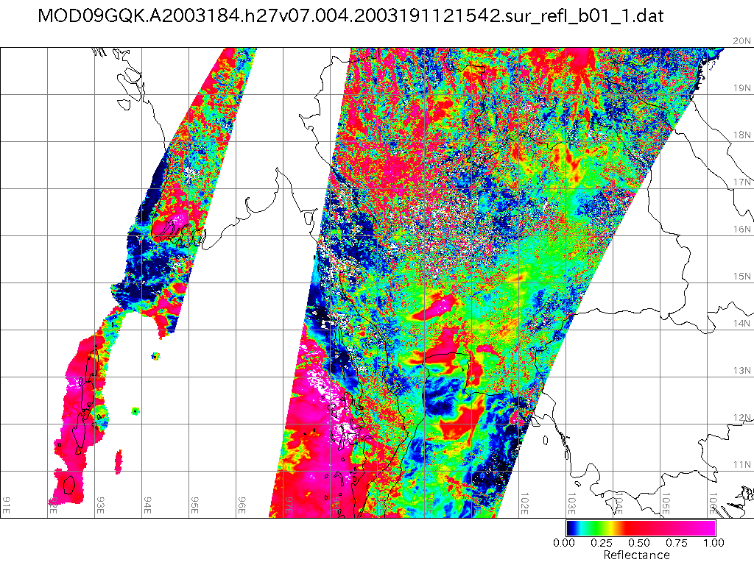
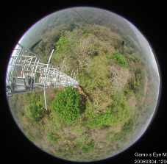
Use Case and Research Issues - Federation of CO₂ Flux data and Satellite data -
Calibration of Satellite Data
using In-situ Observation Data
Global CO₂ Map generated from In-situ data and Satellite data
Apply to the similar vegetation area
Research Issues and approach
(1) Development of IT infrastructure which federates distributed and heterogeneous Earth observation data.
Approach: Integration of Grid and OGC standards
(2) Establishment of multi-disciplinary and cross boundary scientific community
Approach: Linking IT and application networks
MKL
SKR
TKY
Digital
Camera
Satellite data
Flux Tower

Slide 20



Research Themes
Research Theme 1
Evaluate and improve GEO Grid middleware for practical use through empirical experiments.
１．Catalog search
２．Data query
３．Processing
４．Results & visualization
Research Theme 2
Implementation of secure and scalable OGC standards using Grid technologies.
CSW
WMS
WFS
WCS
WPS
Research Theme 3
Development of Asia GEO Grid Infrastructure which federates heterogeneous and distributed Earth observation data.
GEO Grid
Integration of heterogeneous and distributed DBs
Flexible and user friendly security
High performance and scalable catalogue services
Development of model cases at Flux observation sites
Outcomes of the other research projects
One of research themes in this project
Expected outcome
Development of sustainable infrastructure and community for Earth sciences
Contribution to GEO and International standards

Slide 21

Summary
Develop an infrastructure and communities which federates multi-disciplinary and cross-boundary data, people, and knowledge
GEO Grid 広域環境観測情報統合プラットフォーム
JapanFlux/AsiaFlux
（陸域炭素循環）
（DB, GIS, Work Flow...）
PEN/PEN Overseas
（フェノロジー観測）
From human network
To multi-disciplinary and
cross-boundary
Information network
JaLTER/ILTER
（長期生態系研究）
Expected outcomes
（current）
No infrastructures for communities
Contribute to solve environmental problems in Asia
Extend to various application networks other than Flux Network.
J-BON/GEO BON
ASTER/GCOM-C/MODIS
（生物多様性観測）
（衛星観測）
（シミュレーションモデル）
Contribute to GEO through contribution to GEOSS

